Slide 1


Air Quality Prediction Over Ahmedabad Using Machine Learning
Yash Dahima
AU2129002
CSE523 - Machine Learning
Mid Sem Project Presentation

Slide 2
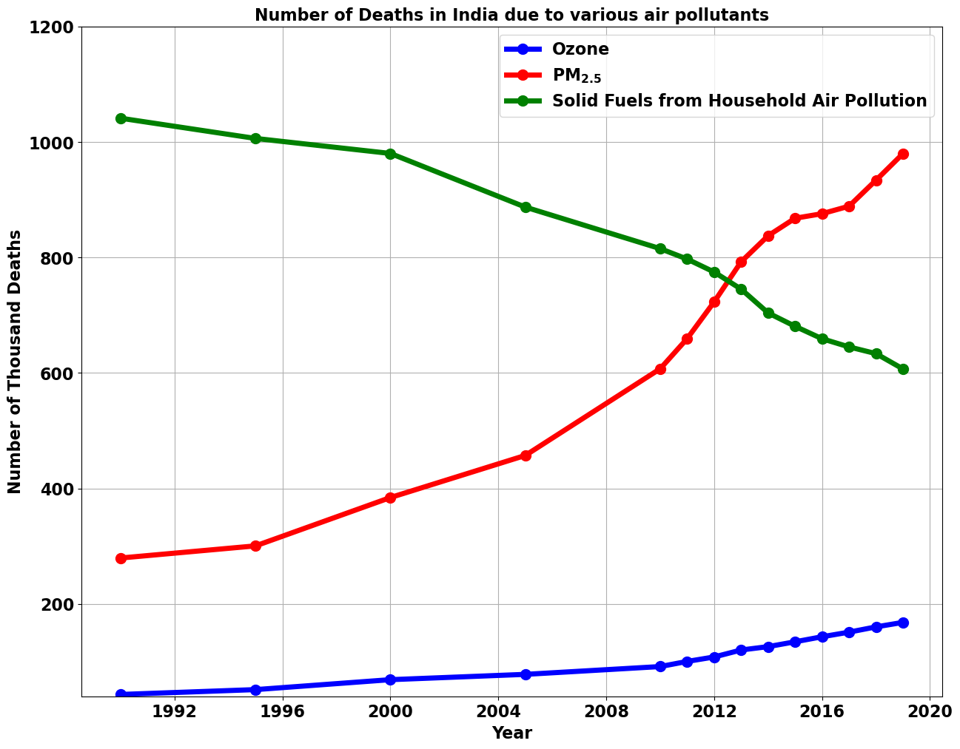
INTRODUCTION
WHO – ‘‘Clean air is considered to be a basic requirement of human health and well-being. However, air pollution continues to pose a significant threat to health worldwide.’’
Air Pollutants – CO, CO₂, Particulate Matter (PM), NO₂, SO₂, etc.
The airborne solid particles having size less than 2.5 µm are called PM_{2.5} pollutants.

Slide 3
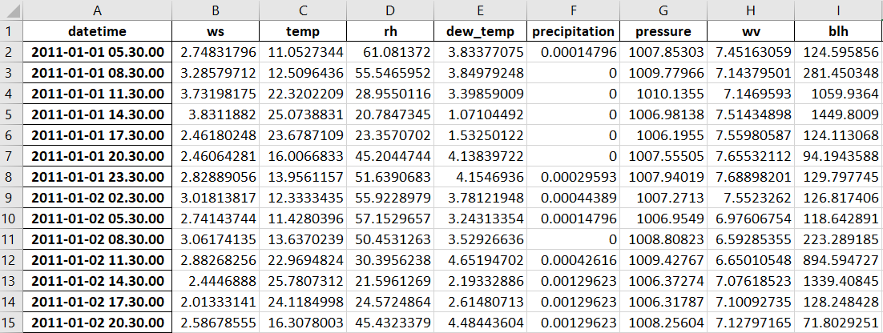
DATASET
Study Region: Ahmedabad & Study Period: 2011-2019

Slide 4
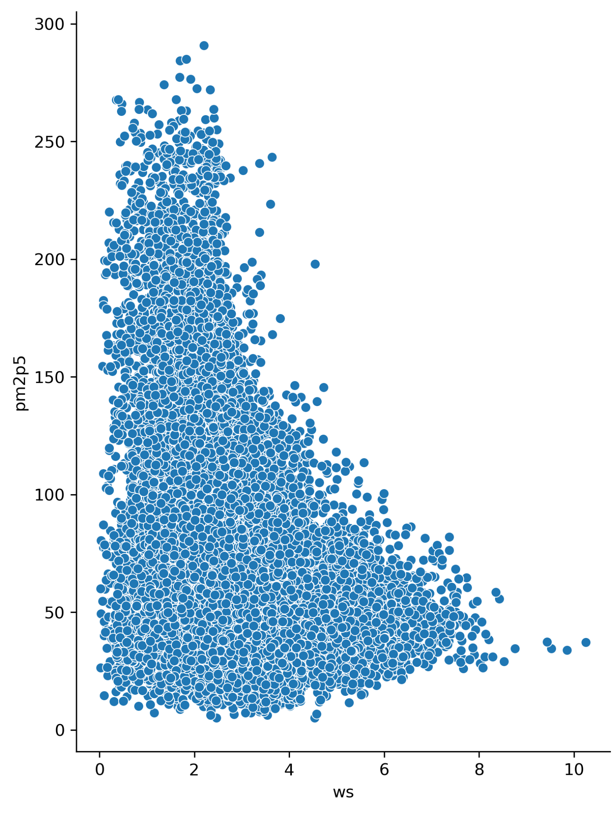
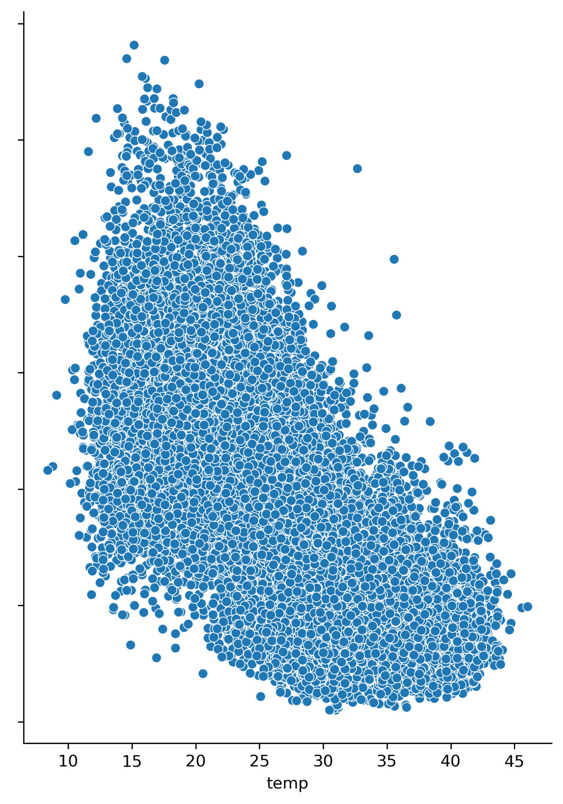
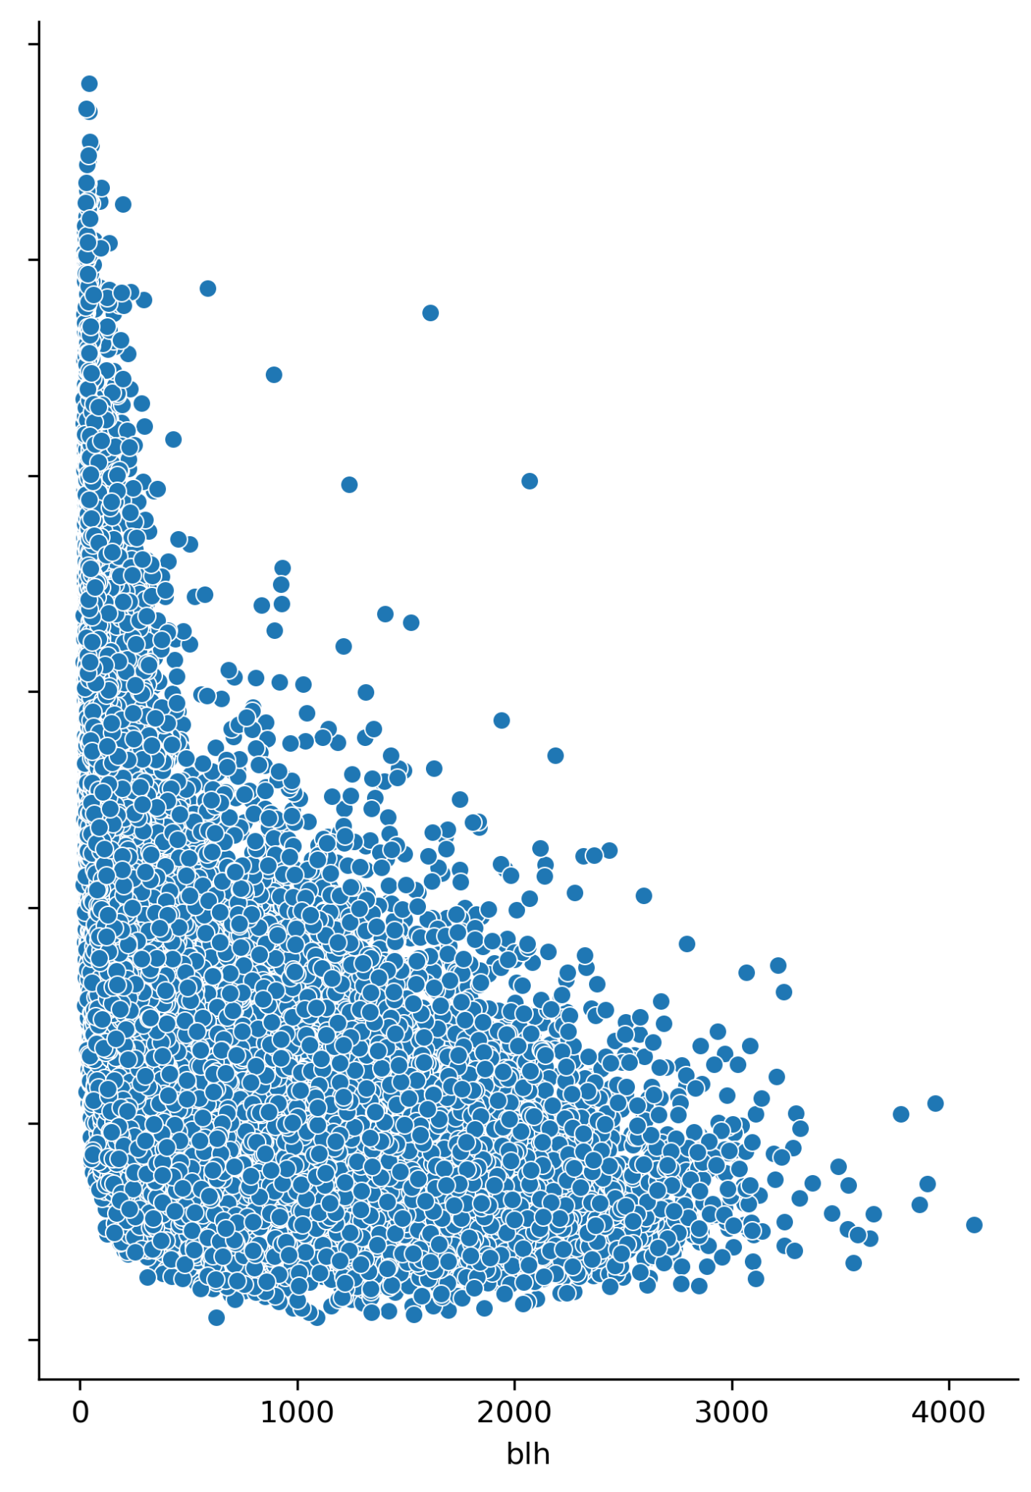
EDA

Slide 5
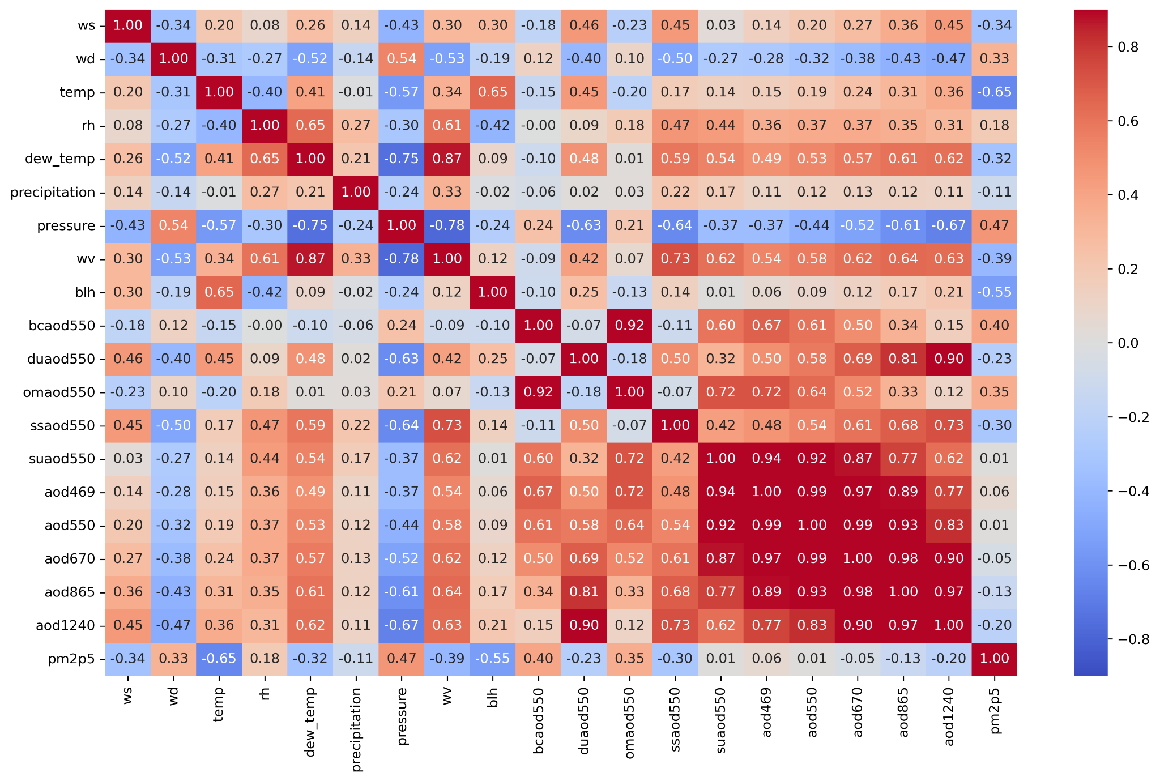
Correlation Matrix

Slide 6
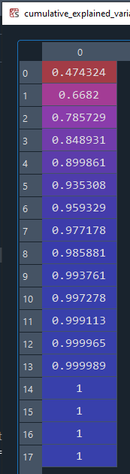
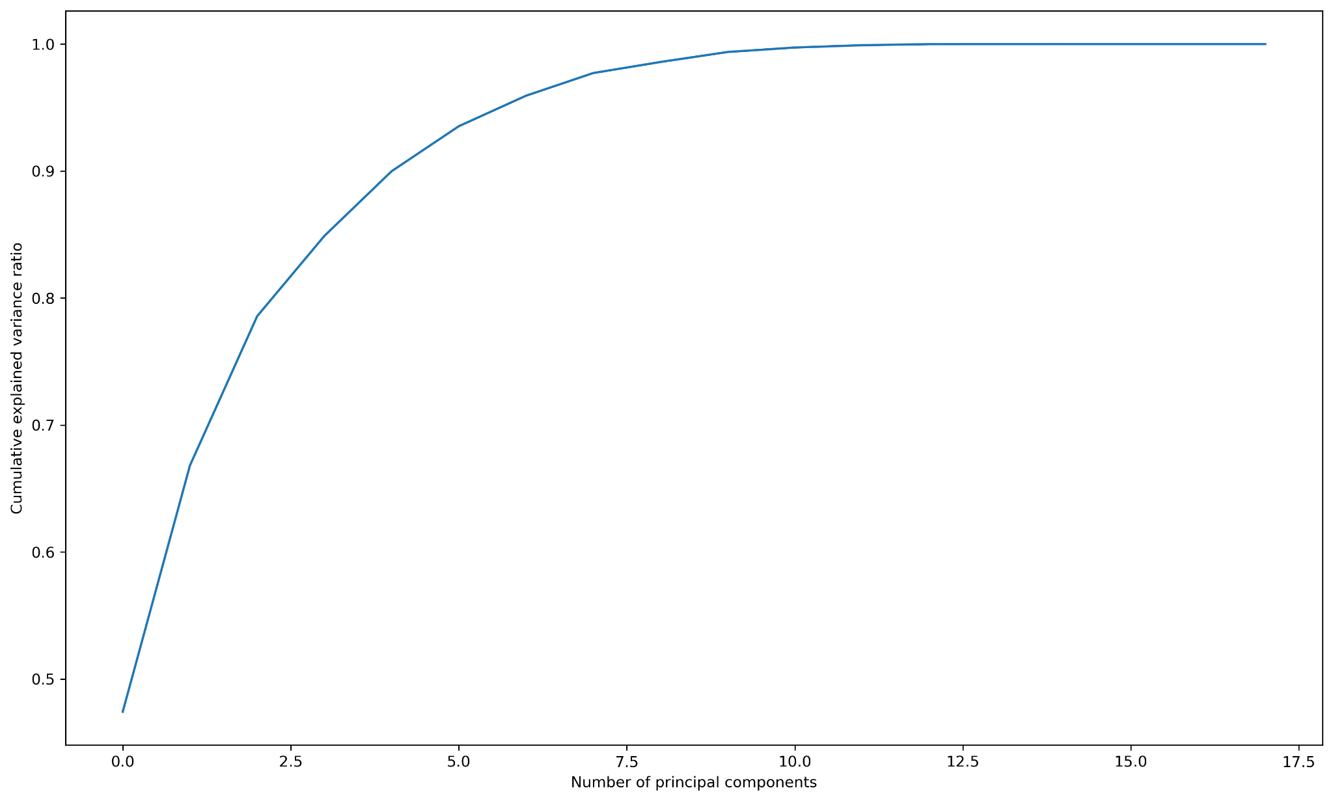
PCA

Slide 7
REFERENCES
[1] Kumar, K., Pande, B.P. Air pollution prediction with machine learning: a case study of Indian cities. Int. J. Environ. Sci. Technol. (2022). https://doi.org/10.1007/s13762-022-04241-5
[2] Doreswamy HKS, Yogesh KM, Gad I (2020) Forecasting Air pollution particulate matter (PM2.5) using machine learning regression models. Procedia Comput Sci 171:2057–2066. https:// doi. org/ 10. 1016/j. procs. 2020. 04. 221
[3] Madhuri VM, Samyama GGH, Kamalapurkar S (2020) Air pollution prediction using machine learning supervised learning approach. Int J Sci Technol Res 9(4):118–123

